Slide 1


Lab 4
Multi-variable linear regression
With PyTorch 0.2.0_2
Sung Kim <hunkim+ml@gmail.com>
Code: https://github.com/hunkim/DeepLearningZeroToAll/

Slide 2
Lab 4-1
Multi-variable linear regression
With PyTorch 0.2.0_2
Sung Kim <hunkim+ml@gmail.com>
Code: https://github.com/hunkim/DeepLearningZeroToAll/

Slide 3
https://github.com/hunkim/DeepLearningZeroToAll/tree/master/pytorch
https://github.com/hunkim/DeepLearningZeroToAll/blob/master/pytorch/lab-04-2-multi_variable_linear_regression.py

Slide 4
Hypothesis using matrix
x₁ | x₂ | x₃ | Y
73 | 80 | 75 | 152
93 | 88 | 93 | 185
89 | 91 | 90 | 180
96 | 98 | 100 | 196
73 | 66 | 70 | 142
Test Scores for General Psychology
Notes:
\begin{pmatrix}x_1&x_2&x_3\end{pmatrix}\cdot \begin{pmatrix}w_1\\ w_2\\ w_3\end{pmatrix}=\begin{pmatrix}x_1w_1+x_2w_2+x_3w_3\end{pmatrix}

Slide 5
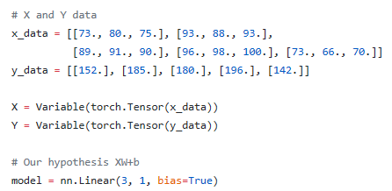
Hypothesis using matrix
x₁ | x₂ | x₃ | Y
73 | 80 | 75 | 152
93 | 88 | 93 | 185
89 | 91 | 90 | 180
96 | 98 | 100 | 196
73 | 66 | 70 | 142
Test Scores for General Psychology
https://github.com/hunkim/DeepLearningZeroToAll/blob/master/lab-04-1-multi_variable_linear_regression.py
Notes:
\begin{pmatrix}x_1&x_2&x_3\end{pmatrix}\cdot \begin{pmatrix}w_1\\ w_2\\ w_3\end{pmatrix}=\begin{pmatrix}x_1w_1+x_2w_2+x_3w_3\end{pmatrix}

Slide 6
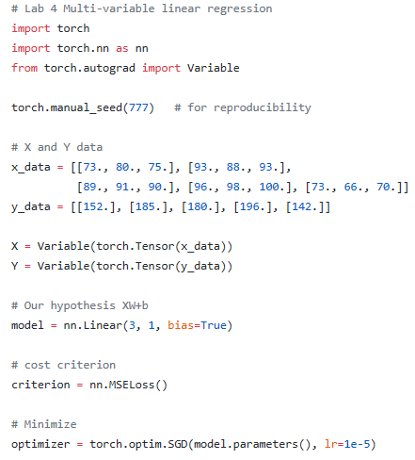
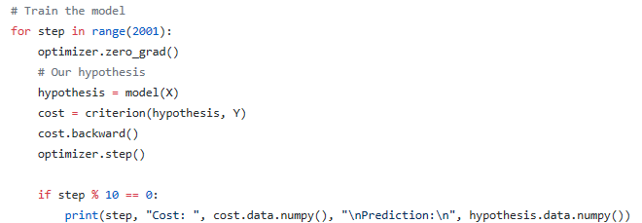
https://github.com/hunkim/DeepLearningZeroToAll/blob/master/pytorch/lab-04-2-multi_variable_linear_regression.py

Slide 7
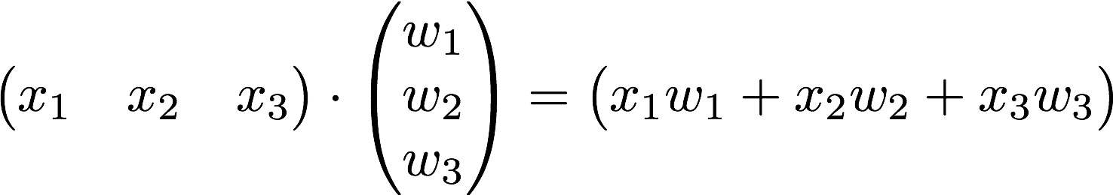

Matrix

Slide 8
Matrix
https://github.com/hunkim/DeepLearningZeroToAll/blob/master/pytorch/lab-04-2-multi_variable_linear_regression.py

Slide 9
https://github.com/hunkim/DeepLearningZeroToAll/blob/master/lab-04-2-multi_variable_matmul_linear_regression.py

Slide 10

Lab 4-2
Loading Data from File
With TF 1.0!
Sung Kim <hunkim+ml@gmail.com>
Code: https://github.com/hunkim/DeepLearningZeroToAll/

Slide 11
https://github.com/hunkim/DeepLearningZeroToAll/tree/master/pytorch
https://github.com/hunkim/DeepLearningZeroToAll/blob/master/pytorch/lab-04-3-file_input_linear_regression.py

Slide 12
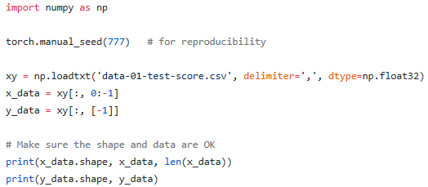
Loading data from file
data-01-test-score.csv
# EXAM1,EXAM2,EXAM3,FINAL
73,80,75,152
93,88,93,185
89,91,90,180
96,98,100,196
73,66,70,142
53,46,55,101
https://github.com/hunkim/DeepLearningZeroToAll/blob/master/pytorch/lab-04-3-file_input_linear_regression.py

Slide 13
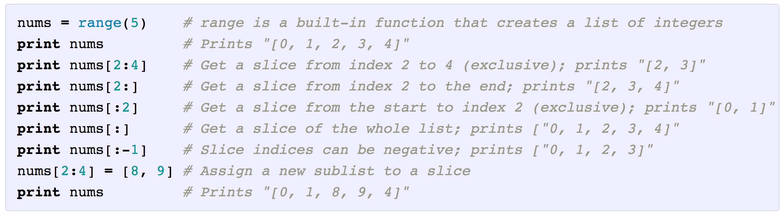
Slicing
http://cs231n.github.io/python-numpy-tutorial/

Slide 14
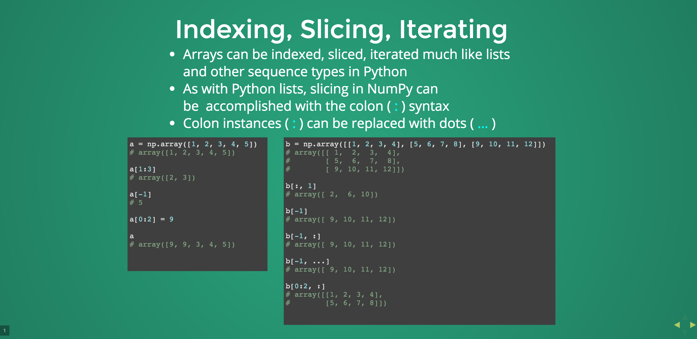
http://slides.com/wigging/numpy#/9

Slide 15
Loading data from file
data-01-test-score.csv
# EXAM1,EXAM2,EXAM3,FINAL
73,80,75,152
93,88,93,185
89,91,90,180
96,98,100,196
73,66,70,142
53,46,55,101
https://github.com/hunkim/DeepLearningZeroToAll/blob/master/pytorch/lab-04-3-file_input_linear_regression.py

Slide 16
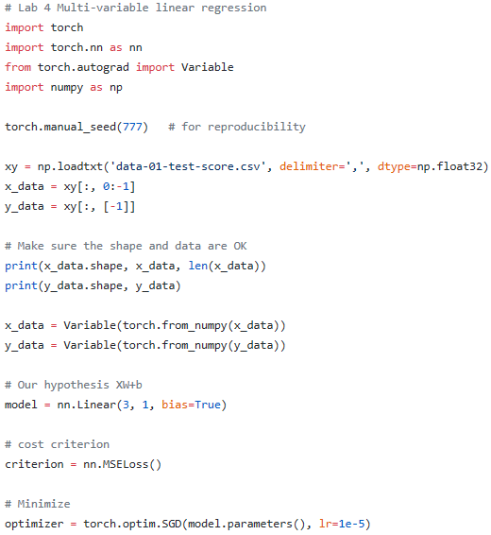
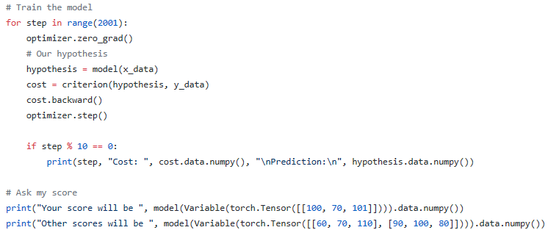
https://github.com/hunkim/DeepLearningZeroToAll/blob/master/pytorch/lab-04-3-file_input_linear_regression.py

Slide 17

Output
https://github.com/hunkim/DeepLearningZeroToAll/blob/master/lab-04-3-file_input_linear_regression.py

Slide 18
https://github.com/hunkim/DeepLearningZeroToAll/blob/master/pytorch/lab-04-3-file_input_linear_regression.py

Slide 19
Lab 5
Logistic (regression) classifier
With PyTorch 0.2.0_2
Sung Kim <hunkim+ml@gmail.com>

